Slide 1
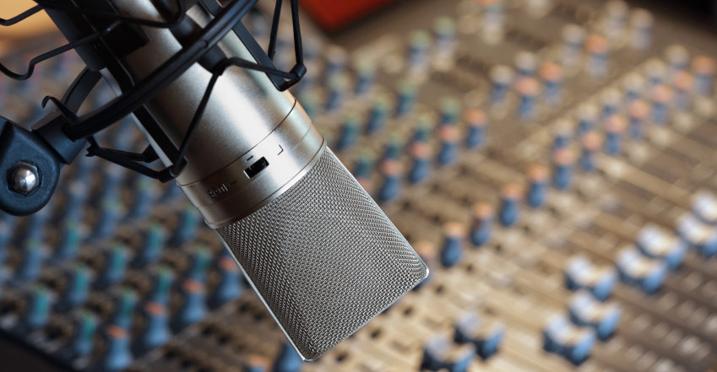

Mo’ Signal Mo’ Betta
MULTI-MICROPHONE DENOISING
Karl Ni
Notes:
Spread out microphones throughout the room
Isolate
Denoise

Slide 2
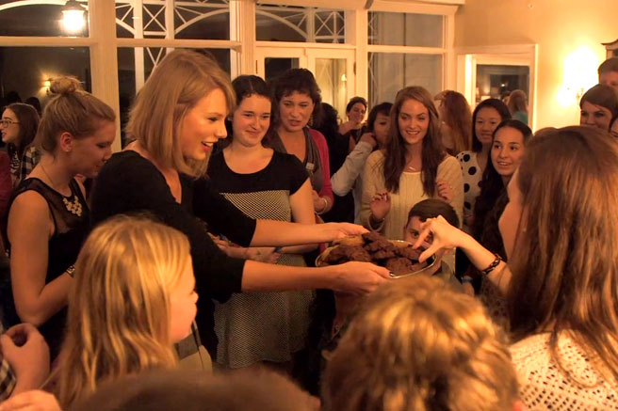
Notes:
You’re Taylor Swift & Katie Perry has a mole in your entourage (since we have bad blood).
Somehow you know that this spy broke a vase at your party
Luckily before your party you threw a bunch of microphones around the room, since you were in a hurry.
Keypoint: distribute microphones arbitrarily.

Slide 3
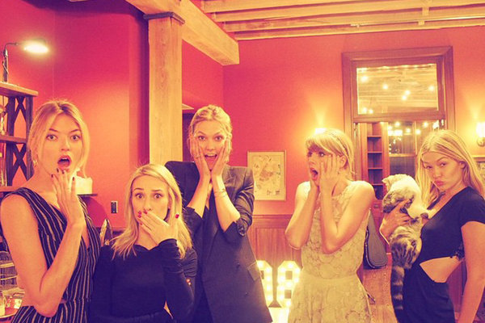

Notes:
Who broke your vase?
Can you hear who broke the vase?
Recording single mic recording
A couple weeks ago, coded some beamforming code
Thanks everyone for volunteering

Slide 4






WHY SHOULD YOU CARE?
IMPACT AND COLLABORATION
OPERATIONAL
ECONOMIC
MISSION
INDUSTRY
ACADEMIA
Notes:
`Talked to PAG on a trip East
Mission: Get in, place sensors, and get out
Don’t want to calibrate, measure distances between mics, etc
Be safe, be quick
Ensure their safety while mission success
Unique position - Work with academia & industry
Vesper – MEMS hardware; vested interested effect better software (10 cubic-mic)
CAPIO – considerable experience in algorithms, built models (Ian Lane)
Academia
ICSI –
CUSP
Talking to PAG and Dave G (after his meetings w/CIA+NSA); their mission = get in, place sensors, get out
Ensuring Safety and Mission Success
Impact
(Operational) PAG: Quick sensor placement & reliable data recovery
(Economic) Cheap COTS alternative that is simple and works
(Mission) Capability in enhances problems in other speech areas
(Community) Lab41 and IQT
MULTIPLE COMPANIES: Denoising from multimicrophone (Vesper).
Two companies. SetemTech
Not credible.

Slide 5
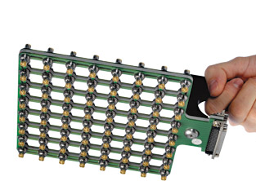


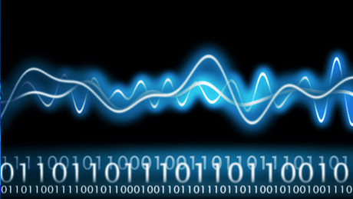

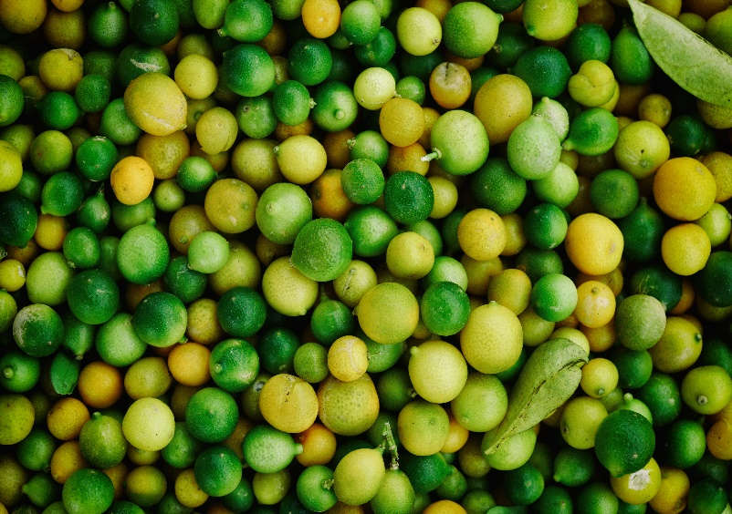
HOW IS THIS DONE TODAY?
RELATED WORK
SINGLE SENSOR
SENSOR ARRAY
DSP-BASED
HIGH ERROR RATES
PROBLEM UNSOLVED
HIGHLY CALIBRATED
KNOWN SENSOR PLACEMENT
SYNCHRONIZED TIMING
POOR COVERAGE
NONLINEAR EFFECTS
Notes:
Speaker diarization through single microphone, not solved in over 20 years
Instead people opt for microphone arrays, highly calibrated
Most of these approaches are heavily signal processing techniques:
Fourier techniques
Matrix factorization / decomposition

Slide 6
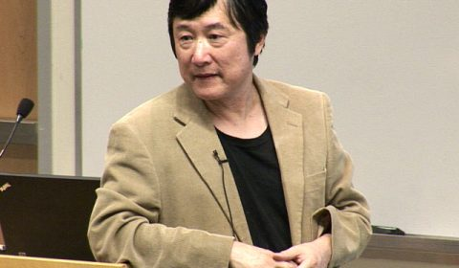

WHY THIS? WHY NOW?
STATE OF THE ART & RELATED WORK
Notes:
For the reasons, like spread out microphones for coverage, quick deployment, and easily hidden
Instead of signal processing techniques, use some deep learning that Li Deng promoItes

Slide 7
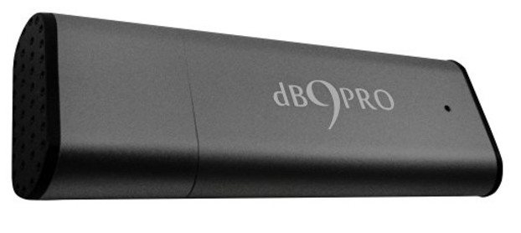
WHAT DO WE NEED?
SPECIFICS AND REQUIREMENTS
10 Amazon microphones $43.29. (Cheaper ones: $16.32)
Two FTE at 7 months
Travel costs
8 offsite campaign
Legal Advisement on Recording
Notes:
Timeline slide

Slide 8






EMAIL
kni@iqt.org
PHONE
650-690-5347
WEBSITE
www.lab41.org
BLOG
www.lab41.org/gab41
Notes:
Contact slide. Feel free to change to suit your needs
----- Meeting Notes (10/28/16 11:43) -----
Doug James - Sound Rendering, Academy Awards. Realistic rendering of sounds. People working in this area on the industry side.

Slide 10
Intelligence Use Case
Urgency for this problem
Fast in Fast out
Attribution group (PAG)
Bonnie (Analyst) “Save lives and improves intelligence”
Coverage, expense, and placement

